Slide 1
Message Routing
Srikanth Gunturu
Guest Faculty
BITS, WILP

Slide 2
In this segment
Message Routing
Simple Routers
Composed Routers
Architectural Patterns – Right option to choose

Slide 3
Message Routing
Simple Routers
Simple Routers are variants of Message Router and route messages from one inbound channel to one or more outbound channels
Flavors include:
Content based router
Message Filter
Recipient List
Splitter
Aggregator
Resequencer

Slide 4
Message Routing
Composed Routers
Composed Routers combine multiple simple routers to create more complex message flows
Flavors include:
Composed Message Processor
Scatter-Gather
Routing Slip
Process Manager

Slide 5
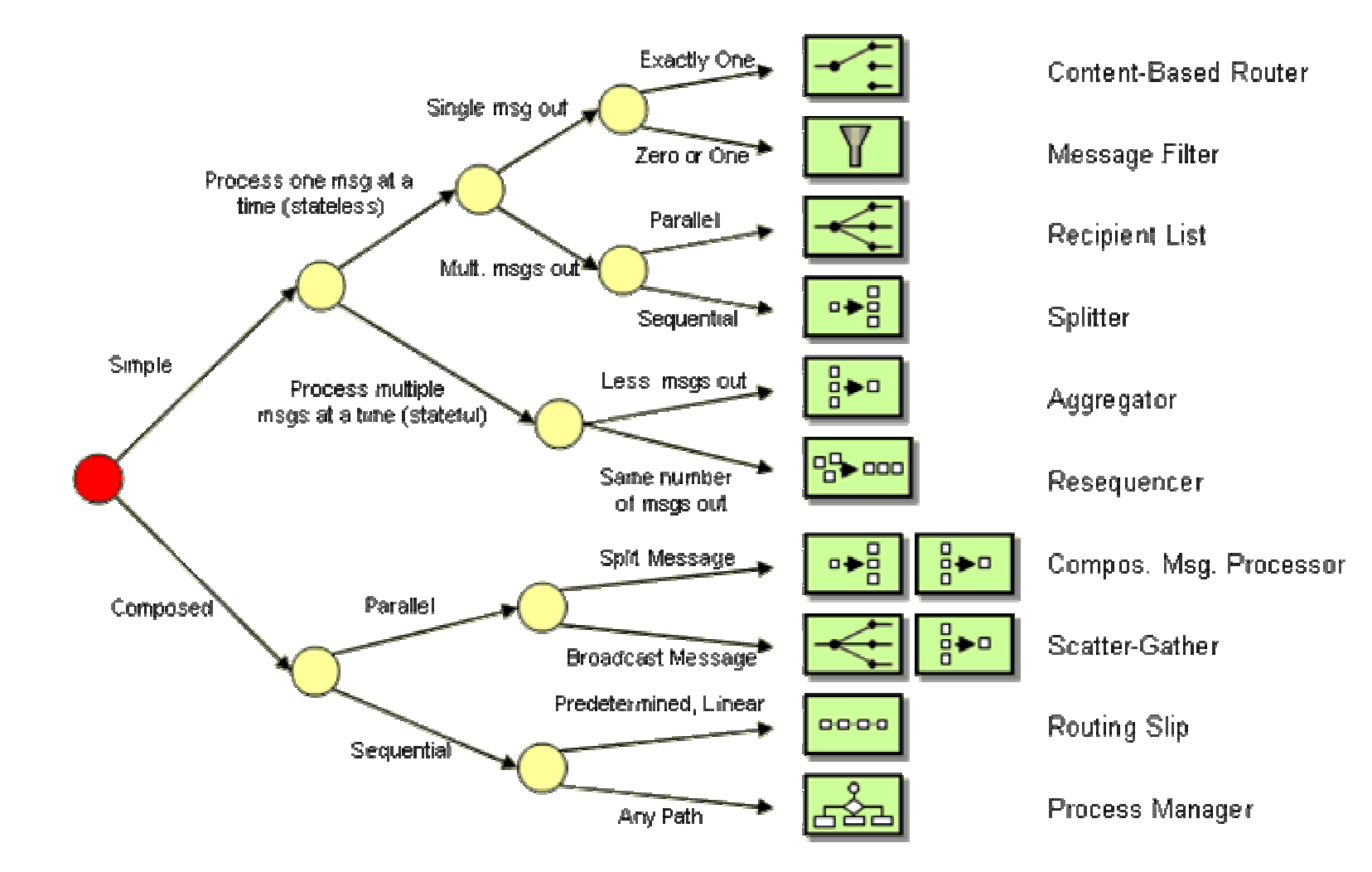
Message Routing
Architectural Styles – Right Option to Choose
Follows a hub-and-spoke architectural style, using central Message Broker
How to choose the right variant

Slide 6
Thank You!
In our next session:
Message Transformation

